Slide 1


Internship Report
Nikhith Ramesh Waddodagi
UMID13032522816
Data Analyst Intern

Slide 2
Agenda
Abstract
Introduction
Technologies used
Results
Conclusion

Slide 3
1) Coca Cola Stock - Live and Updated
Abstract
This report presents a comprehensive real-time analysis of The Coca-Cola Company's stock (NYSE: KO), offering up-to-date insights into its market performance, volatility trends, historical price patterns, and key financial indicators.
Utilizing live data feeds, the report monitors stock fluctuations and integrates technical indicators such as moving averages, RSI, and trading volume to assess market sentiment and momentum.
Additionally, macroeconomic factors, industry benchmarks, and recent corporate developments are examined to provide context to stock movements.
This analysis serves as a valuable tool for investors, financial analysts, and stakeholders seeking to make informed decisions regarding Coca-Cola’s equity performance in the dynamic landscape of the global beverage industry.
3

Slide 4
Introduction
The Coca-Cola Company (NYSE: KO) stands as one of the most iconic and widely recognized brands in the global beverage industry.
As a major player with a long-standing presence in the stock market, Coca-Cola's equity performance attracts significant attention from investors, analysts, and market watchers.
In an era where real-time data and dynamic market conditions influence decision-making, continuous monitoring and analysis of stock behavior have become essential.
This report aims to deliver an in-depth, live, and continuously updated analysis of Coca-Cola’s stock, incorporating a mix of technical indicators, price trends, trading volumes, and financial metrics.
It also examines external factors such as macroeconomic developments, industry shifts, and company-specific news that may impact stock performance.

Slide 5
Technologies used
Data Collection:
Yahoo Finance API : For fetching real-time and historical stock data.
Python Libraries like yfinance to access live and historical stock data. pandas_datareader to Retrieve financial data from sources like FRED.
2. Data Processing & Analysis
Python: Core programming language for scripting and data manipulation.
Pandas: For structured data processing, aggregation, and transformation.
NumPy: For numerical operations and array manipulation.
Scikit-learn: For predictive modeling (e.g., regression, time series forecasting).
Statsmodels: For statistical analysis and trend modeling.
5

Slide 6
3. Data Visualization
Matplotlib and Seaborn: For static plots and charts.
Plotly or Bokeh: For interactive dashboards and real-time data visuals.
4. Storage
SQLite: To store historical data for deeper time-based analysis.
CSV/Excel: For lightweight local storage and exports.
5. Deployment
Git/GitHub: For version control and collaboration.

Slide 7
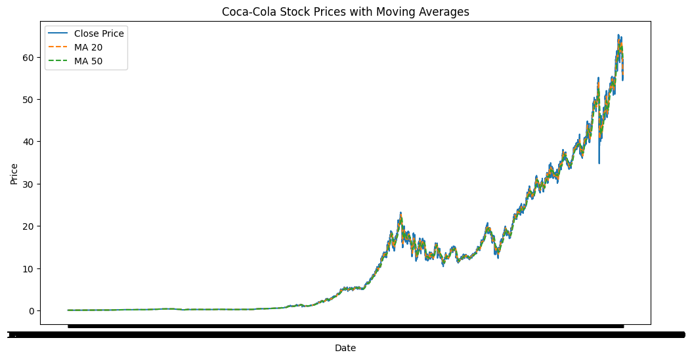
Results

Slide 8
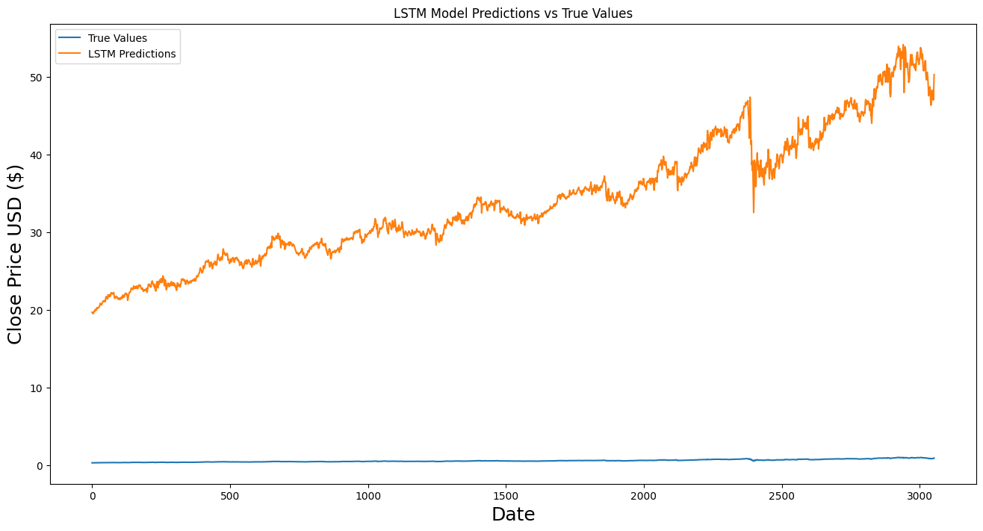

Slide 9
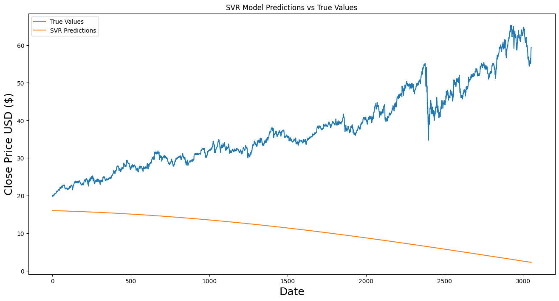

Slide 10
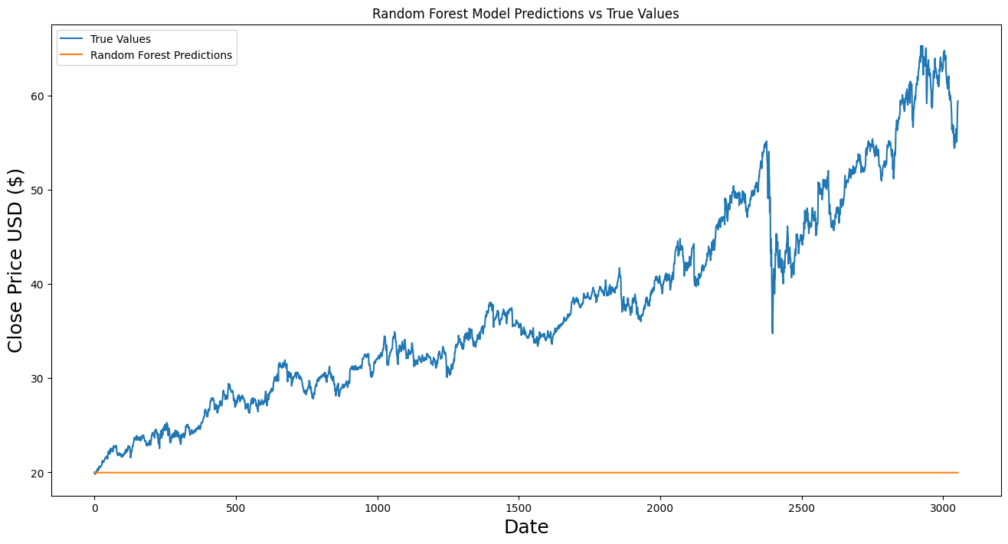

Slide 11
Conclusion
This project provides a comprehensive, data-driven examination of The Coca-Cola Company's stock performance through the integration of real-time data, historical trends, and technical indicators.
By leveraging advanced data analysis tools and visualization technologies, we have uncovered valuable insights into price fluctuations, investor sentiment, and key market drivers influencing KO stock.
The use of modern Python-based libraries, APIs, and dashboard frameworks has enabled dynamic tracking and interactive exploration of Coca-Cola’s stock metrics.
As Coca-Cola continues to navigate an evolving economic landscape, ongoing monitoring through live analytics will remain essential for capturing emerging opportunities and managing risk effectively.

Slide 12
2) Netflix Data: Cleaning, Analysis and Visualization
Abstract
This project focuses on the cleaning, analysis, and visualization of Netflix’s publicly available dataset to extract meaningful insights about its content catalog.
The data was first preprocessed to handle missing values, standardize formats, and remove duplicates.
Exploratory data analysis was then performed to examine trends in content release years, genres, countries of production, and content type distribution.
Finally, visualizations were created using Python libraries to highlight patterns such as the rise of original content, regional contributions, and shifts in genre popularity.
The project provides a clear, data-driven understanding of Netflix’s evolving content strategy and viewer offerings.
12

Slide 13
Introduction
This project aims to explore Netflix's content dataset by performing data cleaning, analysis, and visualization to uncover key trends and insights.
The dataset includes details such as titles, genres, release years, countries, and content types.
After cleaning and preprocessing the data to handle missing values and inconsistencies, exploratory analysis is conducted to identify patterns in content production, genre popularity, and regional distribution.
Visualizations are then used to present findings clearly, offering a concise overview of Netflix’s evolving content strategy.

Slide 14
Technologies used
1. Python
Python was the core programming language used due to its simplicity and powerful data science ecosystem. It enabled efficient data manipulation, analysis, and visualization throughout the project.
2. Pandas
Pandas was used for data cleaning and preprocessing tasks. It allowed easy handling of missing values, duplicate records, data type conversions, and formatting of date and string fields. Grouping and filtering operations helped segment the data for analysis.
3. NumPy
NumPy supported Pandas by providing fast array operations and numerical calculations, especially helpful for date manipulations and conditional logic in the dataset.

Slide 15
4. Matplotlib
Matplotlib was used to create basic visualizations such as bar charts, line graphs, and histograms to represent trends like the number of titles added per year or the distribution of content types.
5. Seaborn
Seaborn provided higher-level, visually appealing statistical plots like heatmaps, count plots, and category comparisons. It was used to analyze relationships between variables such as release year vs. genre or country vs. content count.
6. Jupyter Notebook / Google Colab
Both platforms were used as development environments for writing and executing Python code. They supported interactive data analysis and visualization in a notebook format, making it easier to document findings and share results.

Slide 16
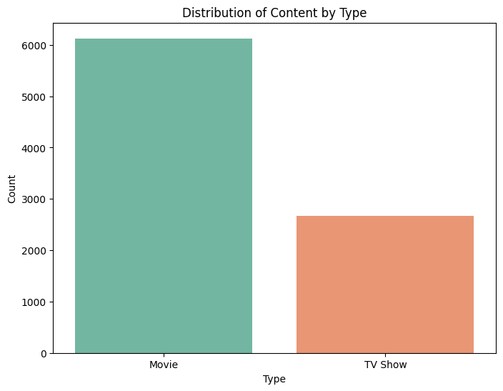
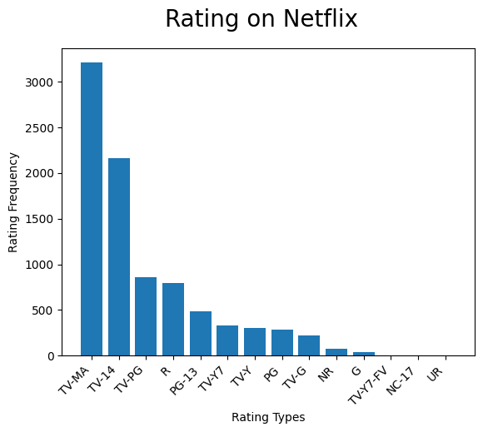
Results

Slide 17
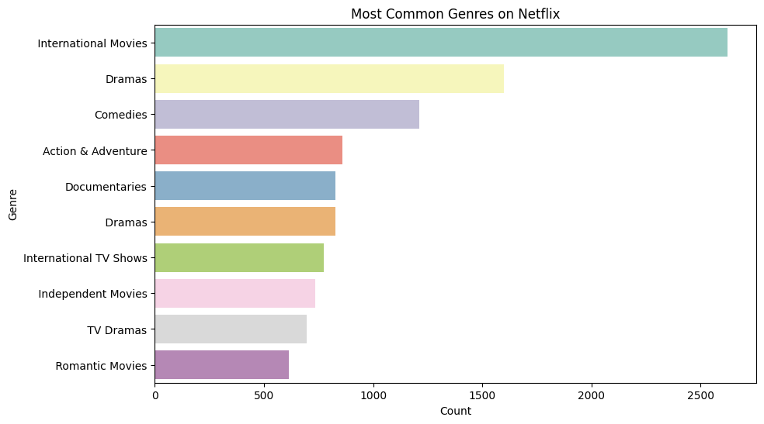
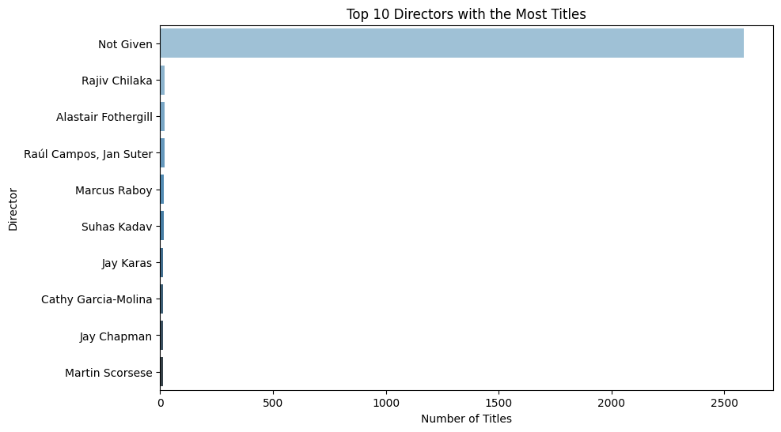

Slide 18
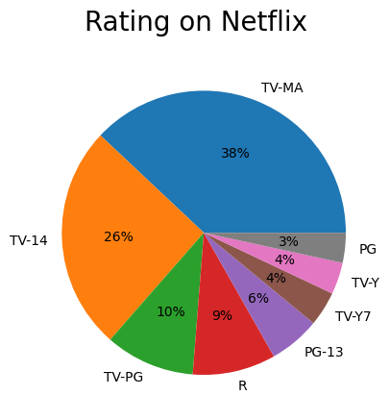
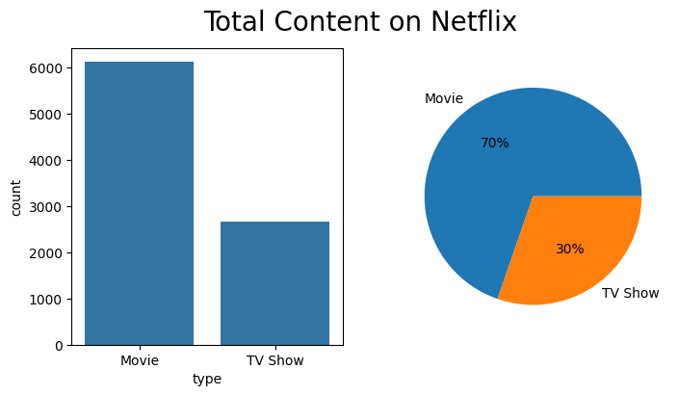

Slide 19
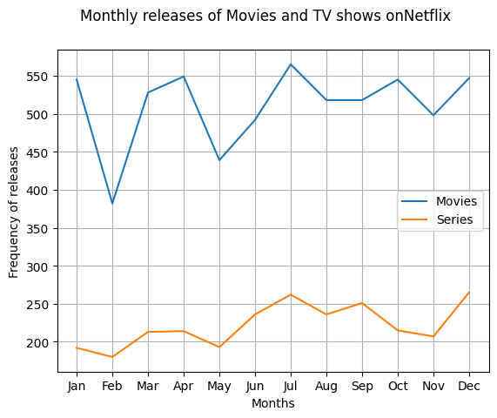
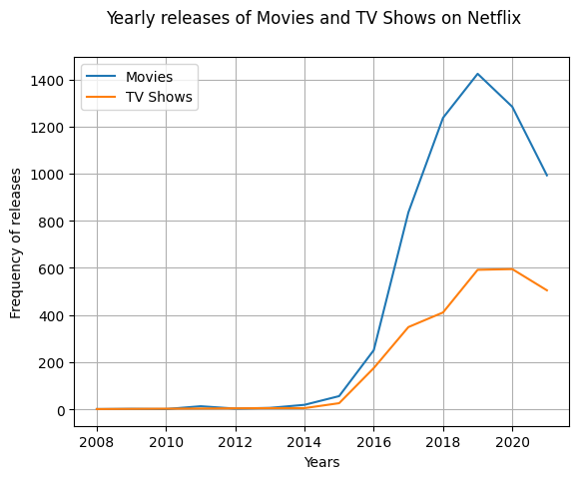

Slide 20
Conclusion
This project successfully explored and analyzed the Netflix dataset by applying systematic data cleaning, insightful analysis, and effective visualization techniques.
Through the use of Python and its powerful libraries, we identified key trends in Netflix’s content catalog, including patterns in genre distribution, content types, country-wise contributions, and release timelines.
The findings provide a deeper understanding of Netflix’s content strategy and global expansion.
This project demonstrates the importance of data-driven analysis in uncovering valuable insights from large, real-world datasets.

Slide 21
3) Regulatory Affairs of Road Accident Data 2020 India
Abstract
This project analyzes the 2020 road accident data from India with a focus on regulatory affairs, aiming to understand the effectiveness of existing traffic laws and safety regulations.
Using official government datasets, the study examines patterns in accident causes, vehicle types involved, age groups affected, and geographic hotspots.
Data cleaning and visualization techniques were employed to identify key risk factors and policy gaps.
The analysis highlights critical areas where regulatory enforcement and infrastructure improvements are needed, providing data-driven insights to support safer road policies and accident prevention strategies in India.
21

Slide 22
Introduction
Road accidents are a major public safety concern in India, contributing to significant loss of life, injuries, and economic costs each year.
In 2020, despite the reduced mobility due to the COVID-19 pandemic, India reported thousands of road accidents, highlighting persistent issues in traffic management, infrastructure, and regulatory enforcement.
This project focuses on analyzing the 2020 road accident data published by the Ministry of Road Transport and Highways to assess the effectiveness of existing road safety regulations.
By identifying key trends such as accident causes, affected demographics, and high-risk regions, the study aims to support evidence-based improvements in traffic policies, law enforcement, and public safety initiatives.

Slide 23
Technologies used
1. Python
Python served as the primary programming language for data cleaning, analysis, and visualization due to its rich ecosystem of data science libraries.
2. Pandas
Pandas was used for data preprocessing—handling missing values, filtering rows, grouping accident data by state, age group, vehicle type, and cause of accident.
3. NumPy
NumPy supported numerical operations and helped with efficient computations for statistical summaries and data transformations.

Slide 24
4. Matplotlib & Seaborn
These libraries were used for visualizing accident patterns through bar charts, pie charts, line plots, and heatmaps. Key visuals included:
State-wise accident distributions
Accident causes by category
Age and gender-based victim analysis
5. Jupyter Notebook / Google Colab
These platforms provided an interactive environment for running code, visualizing data, and documenting findings in a clean, shareable format.
6. GeoPandas
Used for basic geospatial mapping of accident-prone regions by overlaying accident statistics on state-level maps of India.

Slide 25
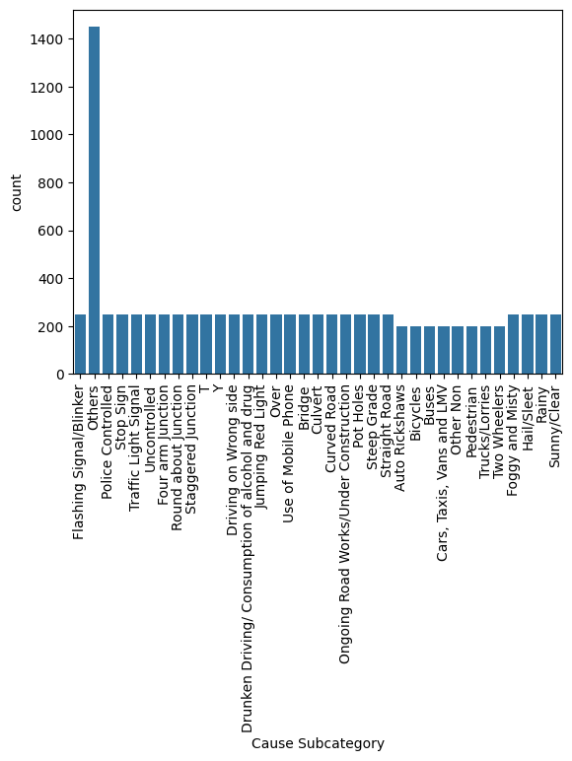
Results

Slide 26
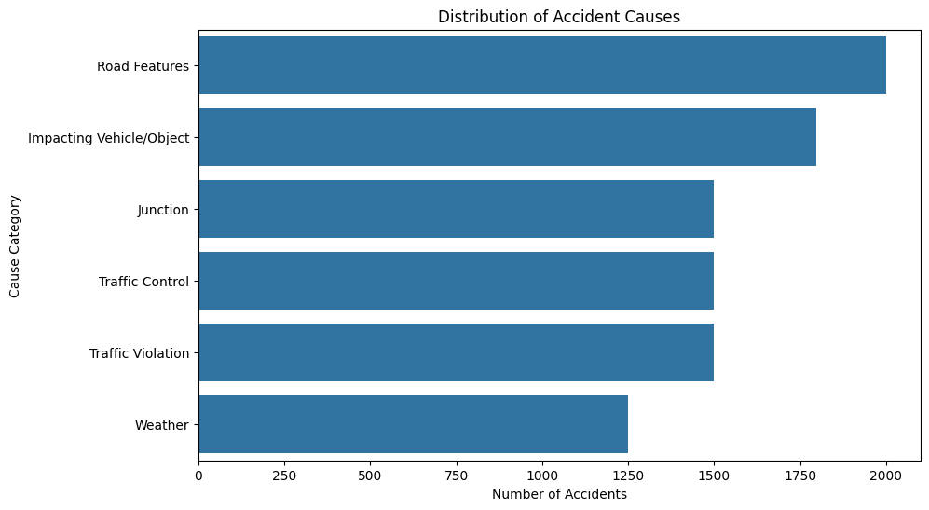

Slide 27
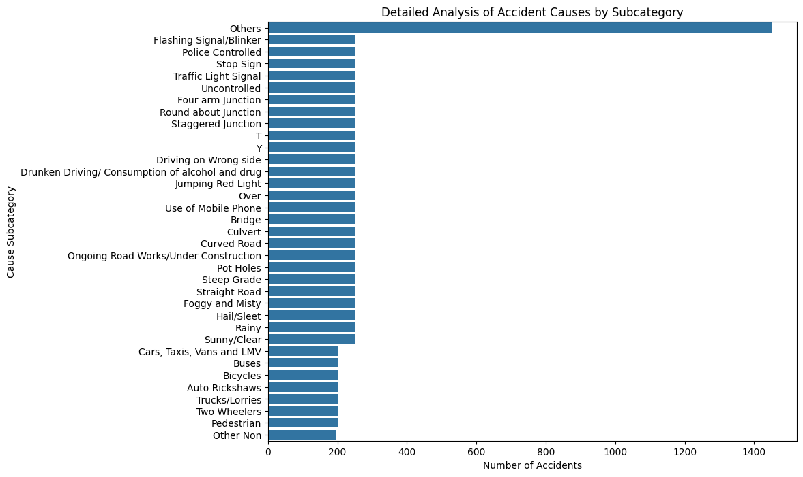

Slide 28
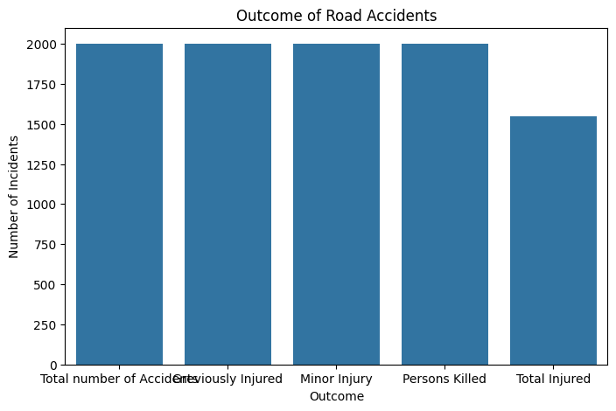

Slide 29
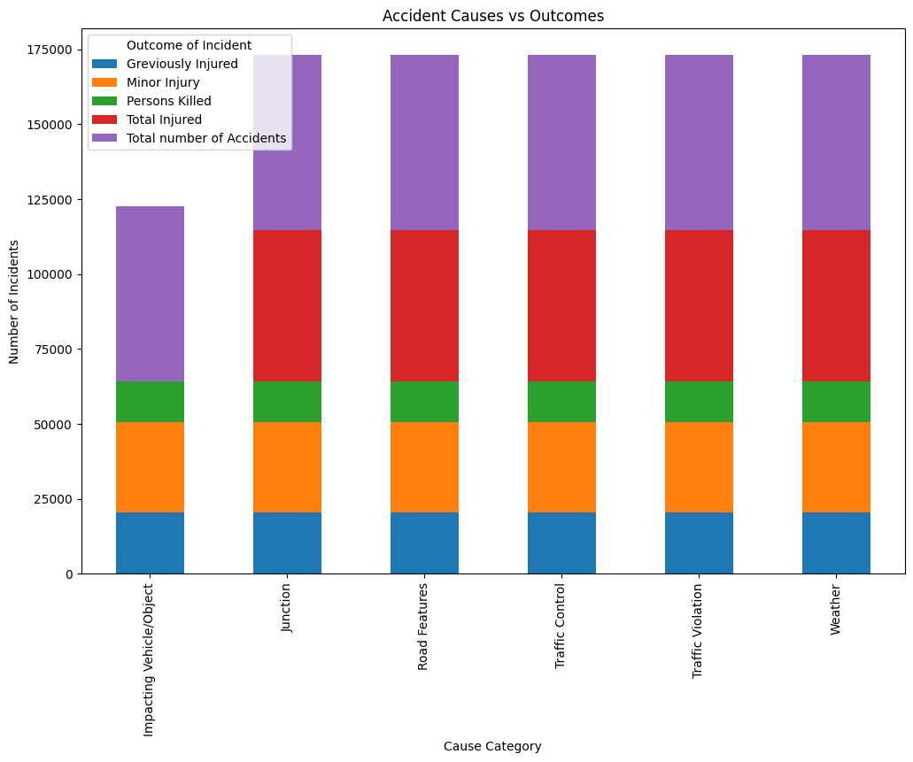

Slide 30
Conclusion
The analysis of India’s 2020 road accident data reveals critical insights into the effectiveness and limitations of current road safety regulations.
Despite reduced traffic during the pandemic year, a significant number of accidents occurred, indicating persistent structural and behavioral issues.
The study highlights key risk factors such as overspeeding, poor road conditions, and lack of enforcement in accident-prone areas.
By leveraging data analytics and visualization tools, this project provides evidence-based recommendations to strengthen regulatory frameworks, enhance public awareness, and improve infrastructure planning.
Continued analysis of such data is essential for shaping more responsive and effective road safety policies in India.

Slide 31
Thank you
Nikhith Ramesh Waddodagi
wrnikhith19@gmail.com
UMID13032522816

